Slide 1
Networking Concepts
By Team 3; Muktika, Abira, Vinne, Gursimrat & Khushi

Slide 2
Topics
Some Basic Concepts (Abira)
Web Servers & Web Pages (Gursimrat)
Domain Names & IP Addresses (Khushi)
Mail Servers & Other Types of Servers
Network Routing & ISPs (Vinne)
Local Area & Wide Area Networks & VPNs (Muktika)

Slide 3
2. Some Basic Concepts

Slide 4
2.1 Client Server Model
What is the Client
A client is a piece of computer hardware or software that accesses a service made available by a server. The server is often (but not always) on another computer system, in which case the client accesses the service by way of a network.
What is the Server
a server is a computer program or a device that provides functionality for other programs or devices, called "clients"
This architecture is called the client–server model
a single overall computation is distributed across multiple processes or devices
Servers can provide various functionalities, often called "services", such as sharing data or resources among multiple clients, or performing computation for a client
A single server can serve multiple clients, and a single client can use multiple servers
A client process may run on the same device or may connect over a network to a server on a different device
Provide an example of an application that uses the Client Server Model
Web browsers, chat applications, email software

Slide 5
2.2 Peer-To-Peer Model
What is a Peer
"peers" are computer systems which are connected to each other via the Internet
Files can be shared directly between systems on the network without the need of a central server
How is it different from a Client Server Model
a peer-to-peer network has no central server
Each workstation on the network shares its files equally with the others
The server will determine which users can access the files on the network
there are separate dedicated servers and clients in a client/server network
Through client workstations, users can access most files, which are generally stored on the server. The server will determine which users can access the files on the network
Provide an example of an application that uses the Peer-To-Peer Model
Xunlei, BitComet, Azureus, Emule, eDonkey, LimeWire, WinMX, Winny

Slide 6
2.3 Hyperlinks
What is a Hyperlink?
Also referred to as a link
Definition
a link from a hypertext file or document to another location or file, typically activated by clicking on a highlighted word or image on the screen
How are Hyperlink related to Web Pages?
Hyperlinks are like a shortcut to web pages
E.x. you can send an email with a hyperlink in it or you want the other person to go on the webpage and all they have to do is click it
How are Hyperlinks related to this PowerPoint document?
We are using it as shortcuts so that you can go to whichever you need to go to

Slide 7
2.4 Packets and Data
What is a Data Packet?
A data packet is a unit of data made into a single package that travels along a given network path
they are used in Internet Protocol (IP) transmissions for data that navigates the Web, and in other kinds of networks
What happens to a message (or data) when it is sent across the Internet?
It is changed to binary numbers
this is because data sent over the Internet (and most computer networks) are sent in manageable chunks (these chunks of data are known as packets)
The packets would go through the Application Layer and continue to the TCP layer.

Slide 8
2.5 Firewalls
What is a Firewall?
a part of a computer system or network which is designed to block unauthorized access while permitting outward communication
How does a Firewall protect your computer?
A firewall is a system designed to prevent unauthorised access to or from a private computer network
You need a firewall to protect your confidential information from those not authorised to access it and to protect against malicious users and accidents that originate outside your network.

Slide 9
3. Web Servers & Web Pages

Slide 10
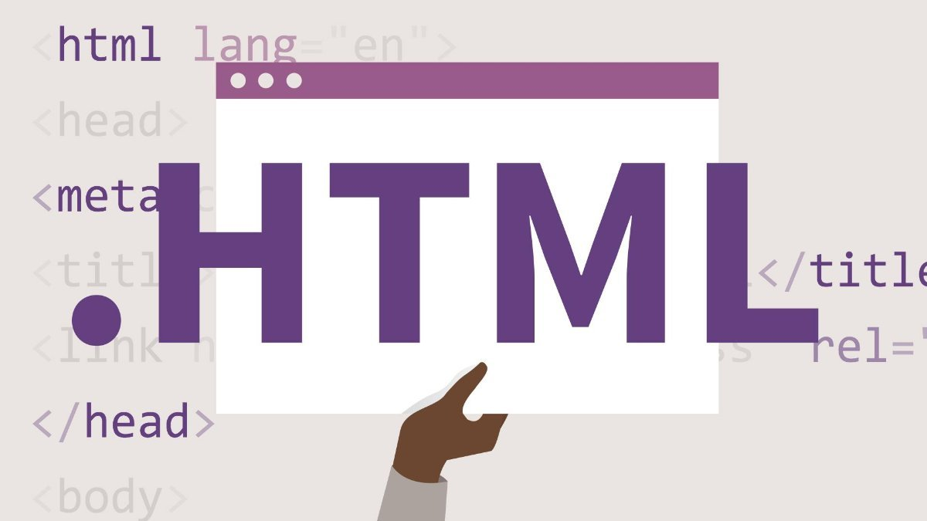
3.1 - HTML & Web Pages
What does HTML stand for?
How are HTMLs related to Web Pages?
What are HTML tags?
<html>, <head>, <title>, <body>
What are other languages used in Web Pages?

Slide 11
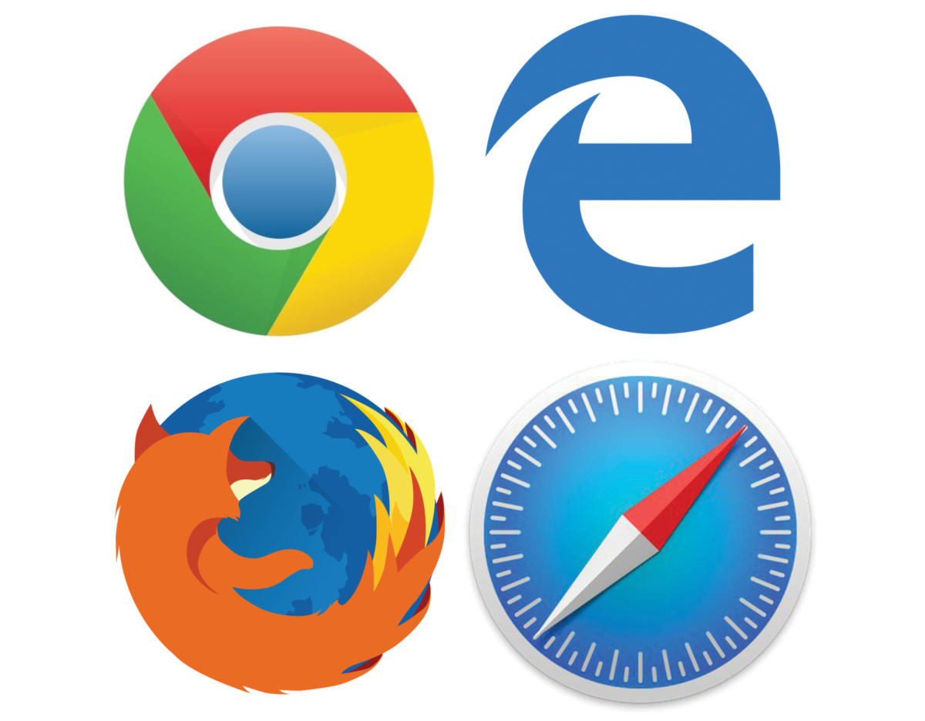
3.2 - Web Client Hardware & Software
What does a Web Browser do?
Common Web Browsers
What are some differences between common Web Browsers?
What are some other types of Web Clients?
Special Hardware and Software

Slide 12
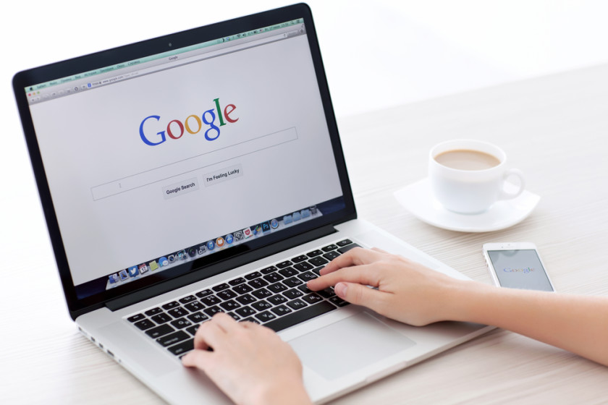
3.3- Browsing a Web Page
What happens when you browse a web page?
What are the main steps?

Slide 13
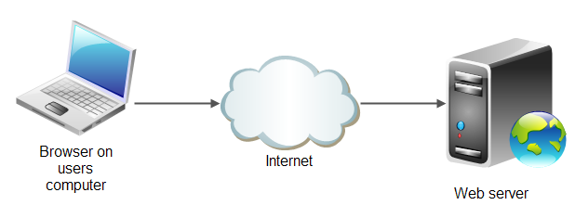
3.4 - Web Servers
What does a Web Server do?
Where are Web Servers located in the Network/ Internet?
Special Software and Hardware

Slide 14
4. Domain Names & IP Addresses

Slide 15
4.1

Slide 16
4.2

Slide 17
4.3

Slide 18
5. Mail & Other Servers

Slide 19
5.1 Mail Servers

Slide 20
5.2 File Servers

Slide 21
5.3 Database Servers

Slide 22
5.4 Other Servers

Slide 23
6. Network Routing & ISPs

Slide 24
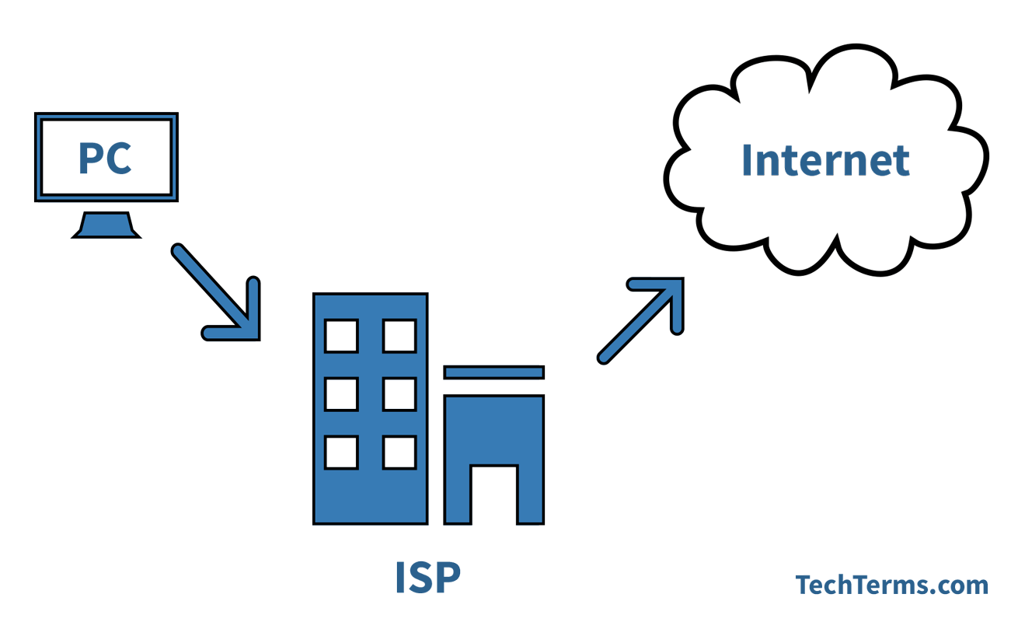
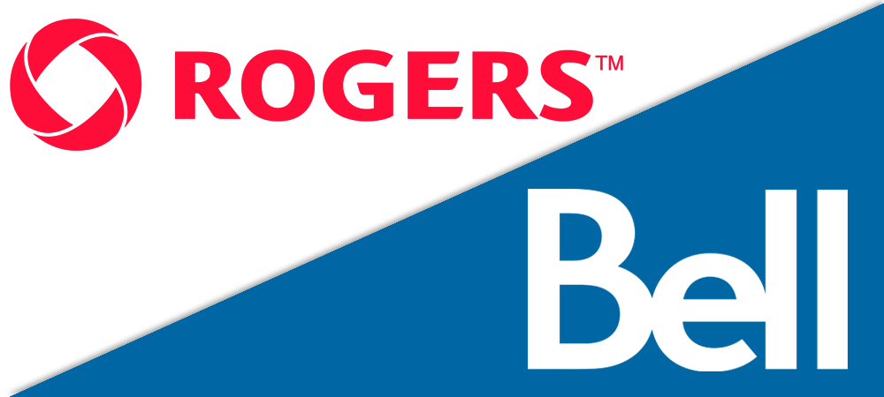
6.1 Internet Service Providers (ISPs)
What is an ISP?
An ISP stands for Internet Service Provider. An ISP is basically the gateway to the internet. In order to use applications online you must have a secure internet connection. Most things on your computer like the Web browser, mail , or whether display will require the access to an internet connection.
http://www.crydee.com/raymond-feist/faq/10605/what-is-an-isp-and-ip-address
What are some common ISPs people use in the Toronto Area?
The two main internet service providers are Rogers and Bell. But there are also manys others ISP’s in the area such as Fido. Teksavvy, Acanac, Velcom, Coextro, Beanfeild Internet, Fibrestream, and Dialog. There are also many other various smaller internet providers. Ultimately when you select an ISP it depends on the type of quality internet you want.
https://www.comparemyrates.ca/blog/top-10-internet-service-providers-toronto/

Slide 25
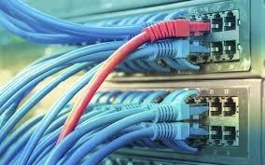
6.1 Internet Service Providers (ISPs)
How is an ISP different from a Internet application / service?
An ISP is different from an internet application service because an ISP is the source or the gateway that provides the internet for applications and services to use. An ISP is different from the applications on your computer because the applications will use the ISP as an source of internet connection. Although some applications may be useable offline such as Microsoft word, you will require an reliable internet connection to work on documents on Google docs. An application is a separate program on your computer that may or may not require an internet connection to function.
https://whatismyipaddress.com/isp

Slide 26
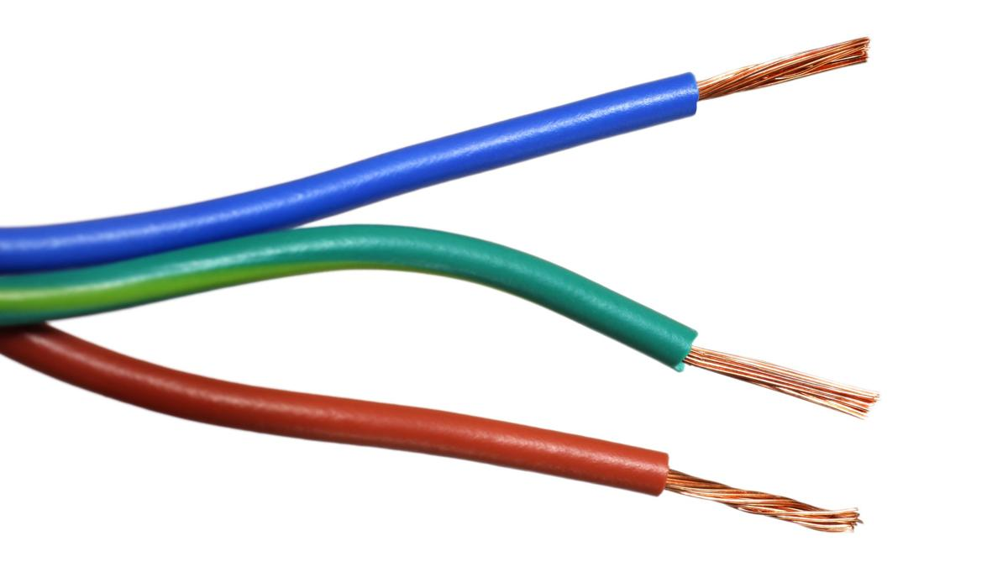
6.2 Internet Connection Technologies
Describe some internet connection technologies using telephone line:
Digital Subscriber Line (DSL) service provides a connection to the Internet through the telephone network. Unlike dial-up, DSL can operate using a single phone line without preventing normal use of the telephone line for voice phone calls. DSL uses the high frequencies, while the low (audible) frequencies of the line are left free for regular telephone communication. These frequency bands are subsequently separated by filters installed at the customer's premises.
DSL is a good internet connection technology because it has many benefits:
Reliable and secure, dedicated connection
More affordable
Can compete in some areas with speeds offered by cable
Best for email, browsing and light internet usage
DSL is available much more widely because it uses the telephone network, which covers just about the entire country due to government mandate. While the presence of telephone lines doesn’t guarantee that DSL will be available, it’s certainly more widespread than cable, so may be your only option.
https://www.highspeedinternet.com/resources/dsl-vs-cable
https://primus.ca/business/en/content-hub/cat/blog/post/what-to-choose-between-cable-or-dsl-internet
some other internet connection technologies that use telephone line are:
Dial-up access.
Multilink dial-up.
Integrated Services Digital Network.
Leased lines.
Cable Internet access.
Digital subscriber line (DSL, ADSL, SDSL, and VDSL)
DSL Rings.

Slide 27
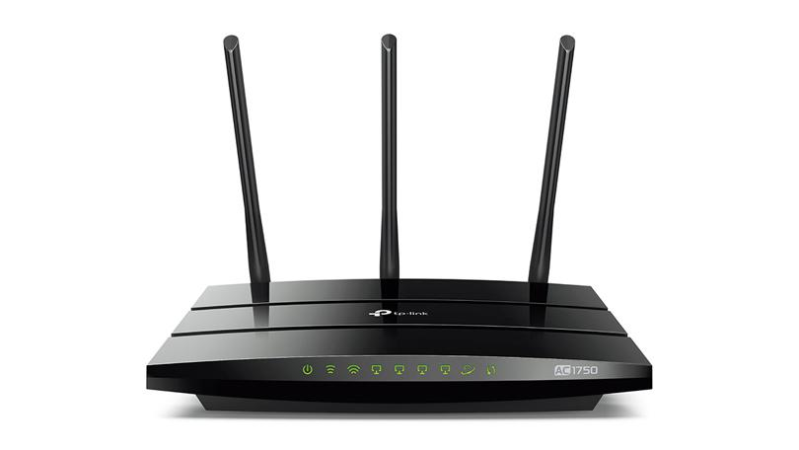
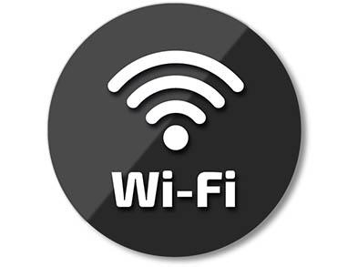
6.2 Internet Connection Technologies
Different types of internet connection using Wifi are:
Describe some internet connection technologies using Wi-Fi
WLANS: Wireless Local Area Networks
WPANS: Wireless Personal Area Networks
WWANS: Wireless Wide Area Networks
VPN: Virtual Private Network
A wireless network allows devices to stay connected to the network but roam untethered to any wires. Access points amplify Wi-Fi signals, so a device can be far from a router but still be connected to the network. Wireless networks usually use routers to transmit radio wave signals to many of the devices.

Slide 28
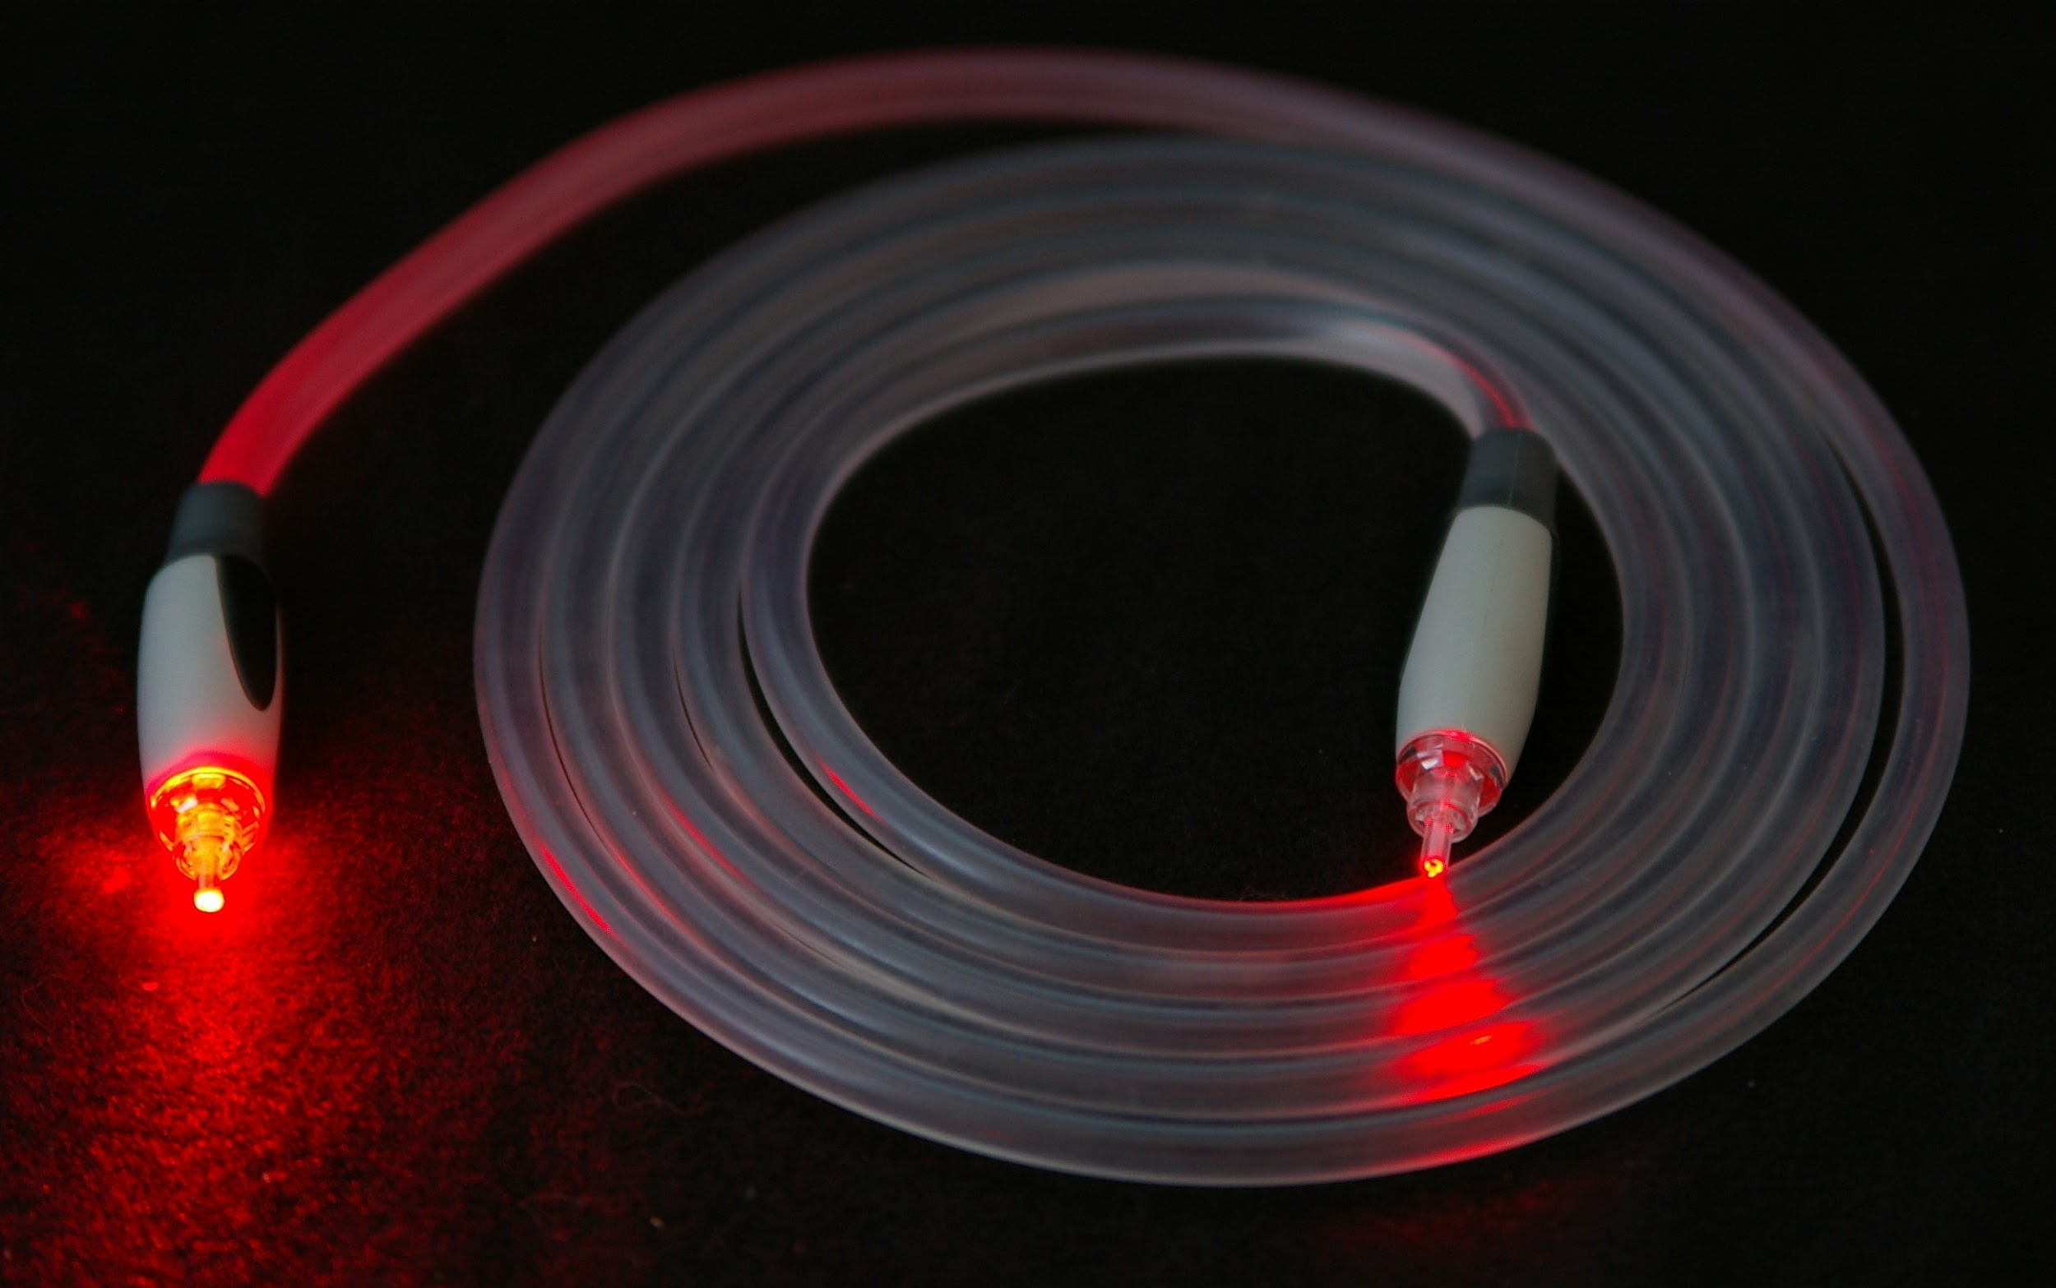
6.2 Internet Connection Technologies
How does fiber optics work?
Describe some internet connection technologies using Fiber Optics
Fiber optics is a way of sending information through thin fibers, or threads. The information may be sound, pictures, or computer codes. This information travels through the fibers in the form of light.
The fibers, known as optical fibers, can be made of glass or plastic. They are about as big around as a human hair. Many fibers are bundled together to form a fiber-optic cable. Fiber-optic cables link some telephones and computers. Doctors also use fiber-optic instruments to see inside the human body.
In a fiber-optic system, a machine called a transmitter turns information into light. Then the transmitter sends the light through optical fibers. The inner part of each fiber is called the core. A reflective material surrounds the core. This material is known as cladding.
https://kids.britannica.com/kids/article/fiber-optics/399455
FTTP/FTTH/FTTB/FTTD: Fiber to the premise, home, business or desktop
are the most direct fiber lines. With them, you are getting pure fiber straight
to your residence, with no copper cables involved. These are also the most
expensive fiber connections for the ISPs.
https://www.otelco.com/resources/a-guide-to-fiber-optic-internet/#fiber-optic-communications

Slide 29
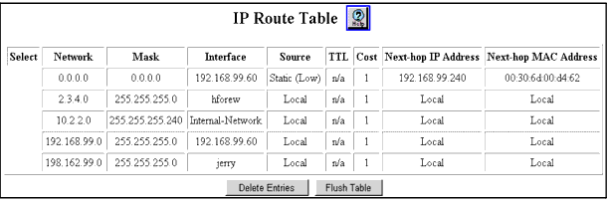
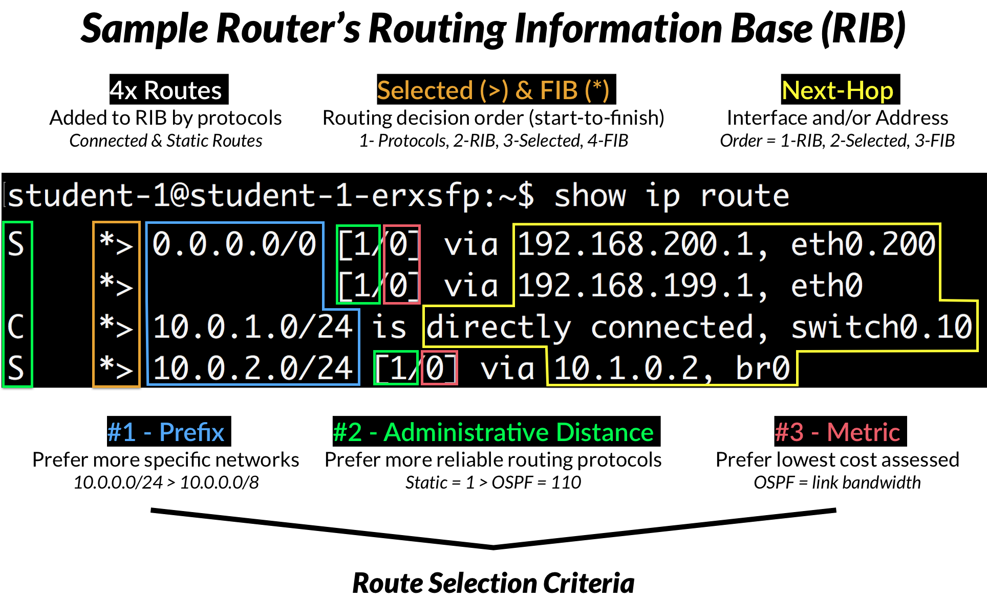
6.3 Network Routers & Switches
What is a "Routing Table”?
Routers examine the destination IP address of a received packet and make routing decisions accordingly. To determine out which interface the packet will be sent, routers use routing tables. A routing table lists all networks for which routes are known. Each router’s routing table is unique and stored in the RAM of the device.
When a router receives a packet that needs to be forwarded to a host on another network, it examines its destination IP address and looks for the routing information stored in the routing table. Each entry in the routing table consists of the following entries:
· the network and the subnet mask – specifies a range of IP addresses.
· the remote router – the IP address of the router used to reach that network.
· the outgoing interface – the outgoing interface the packet should go out to reach the destination network.

Slide 30
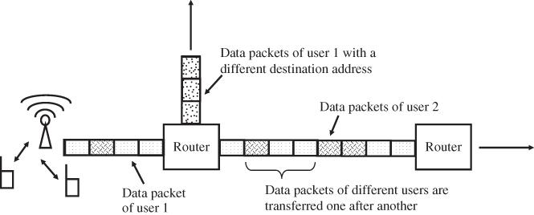
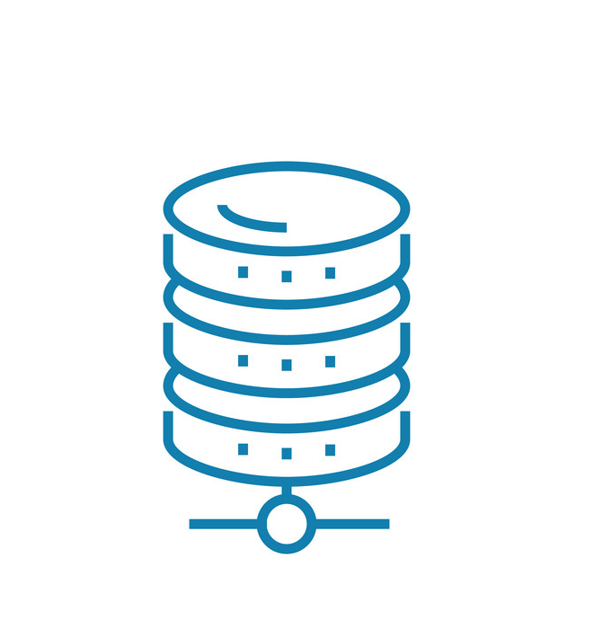
6.3 Network Routers & Switches
How are data packets sent through the internet between a client and a server?
Data packets are sent between a client and a server through a router that uses routing tables. A routing table contains the information necessary to forward a packet along the best path toward its destination. Each packet contains information about its origin and destination. When a packet is received, a network device examines the packet and matches it to the routing table entry providing the best match for its destination. The table then provides the device with instructions for sending the packet to the next hop on its route across the network.

Slide 31
6.3 Network Routers & Switches

Slide 32
7. Type of Networks

Slide 33
7.1 Local Area Networks
What is a Local Area Network?
Local Area Network is a computer network that is used within a small community or the vicinity such as a house, a school, a workplace and other places that use a computer. To add, LAN is a computer network that is very much heard in the society.
Ethernet and Wi-Fi are two important items that allow the LAN connections to occur and that is how computers are able to link to each other or other resources such as printers and file servers. To add, a Local Area Network can be a wired, wireless, or both connection.

Slide 34
What is the purpose of a Local Area Network?
They function to link computers together and provide shared access to printers, file servers, and other services.
What types of applications, servers, and computers are connected to a LAN?
A common LAN configuration is one that supports personal computers. With the relatively low cost of such systems, individual managers within organizations often independently procure personal computers for departmental applications, such as spreadsheet and project management tools, and for Internet access.
In a server-based LAN, devices may connect directly to the server or indirectly via a router or switch.

Slide 35
7.2 Wide Area Networks (WAN)
What is a Wide Area Network?
A network used for a large-scale geographical area
Connects different smaller networks:
Local Area Network (LAN)
Metro Area Network (MAN)
WAN can be set up with the help of public transmission or private network

Slide 36
What is the purpose of a Wide Area Network?
This ensures that computers and users in one location can communicate with computers and users in other locations.
What types of applications, servers, and computers are connected to a WAN?
Types of servers connected to WAN:
LAN (Local Area Network)
MAN (Metro Area Network)
CAN (Campus Area Network)

Slide 37
7.3 Virtual Private Networks (VPN)
What is a Virtual Private Network?
A secure tunnel between your device and the internet. VPNs are used to protect your online traffic from snooping, interference, and censorship.
6 ways a VPN can help you:
Hide your IP and location
Encrypt your communications
Watch your favorite content
Unblock censored websites
Avoid spying and throttling
Find deals and fight ads

Slide 38
How is a VPN different from a LAN / WAN?
A VPN is a secure tunnel between two networks that allows private traffic pass over another network, which may be untrusted. It can be over a WAN but it can also be over a LAN. WAN is simply a wide area network. A typical WAN is your Cable or DSL connection to the Internet.
How could you use a VPN to increase the security of services you use in the Internet?
A VPN lets you increase the security of your web session, transmitted data, financial transactions and personal information online, no matter where you are. Security experts warn against using public Wi-Fi hotspots, such as in a coffee shop, airport or hotel lobby, due to the risk of your connection being hijacked or snooped upon. Internet service providers may invade your privacy by selling data about your online habits to advertisers. A VPN greatly reduces those risks.A VPN might also help to protect you from identity theft; hides your IP address, making it harder for third parties to track you; accesses all content privately without censorship; and bypasses many firewalls.

